Slide 1
Lifestyle Habits and Heart Attack Risk Analysis
Data Analytics Bootcamp
Nava, Rodrigo
Rivero, Haillet
Rosales, José Emiliano

Slide 2
Content
Data Set Characteristics
Data Set Descriptive Statistics
Sequential Analysis of Key Variables
Influence Diet on Heart Attacks
Influence of Alcohol Consumption on Heart Attacks
Influence of Exercise on Heart Attacks
Influence of Sleeping Hours on Heart Attacks
Influence of Location on Heart Attacks
Influence of Income on Heart Attacks
Influence of Triglycerides on Heart Attacks
Influence of Age on Heart Attacks
Multifactorial Analysis on Patients with High Risk of Heart Attack
Alcohol consumption vs. Income per Age
Age vs. physical activity
Cholesterol Level vs. Physical Activity
Conclusions and Data Limitations

Slide 3
Data Set
8763 Observations
20 Countries
26 Variables
Variables
Patient ID
Age
Sex
Cholesterol
Blood Pressure
Heart Rate
Diabetes
Family History
Smoking
Obesity
Sedentary Hours per Day
Income
BMI
Triglycerides
Physical Activity days per Week
Sleep Hours per Day
Country
Continent
Hemisphere
Heart Attack Risk
In this data analysis project, we delve into the exploration of habits that potentially elevate the risk of experiencing a heart attack. Our objective revolves around deciphering the distinctive characteristics of patient behavior and uncovering their correlations with the likelihood of heart attacks. Furthermore, we extend our investigation to examine the interconnections among various variables within the dataset, particularly in patients exhibiting a higher susceptibility to heart attacks. Through this endeavor, our primary aim is to elucidate the information embedded in the dataset and construct a comprehensive overview of a prevalent medical condition: heart disease.

Slide 4
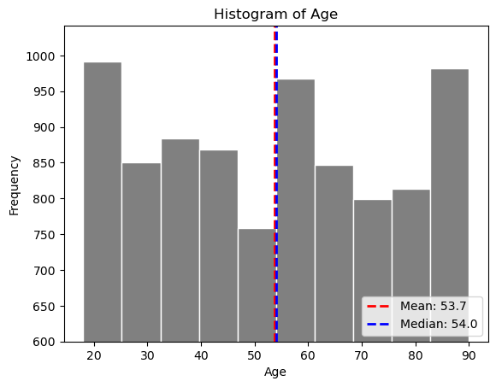
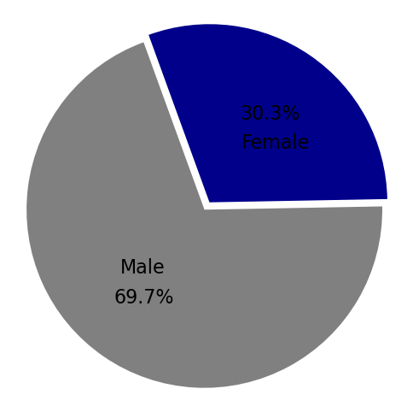
Data Set Descriptive Statistics
Age Distribution
Sex Distribution
Country Distribution
Germany | 477
Argentina | 471
Brazil | 462
United Kingdom | 457
Australia | 449
Nigeria | 448
France | 446
Canada | 440
China | 436
New Zealand | 435
Japan | 433
Italy | 431
Spain | 430
Colombia | 429
Thailand | 428
South Africa | 425
Vietnam | 425
United States | 420
India | 412
South Korea | 409
Mode | 90
Std. Dev | 21.25
Max | 90
Min | 18
The study predominantly included male participants, with 6,107 out of the total sample of 8,763 patients. In contrast, females comprise a minority, accounting for only 2,655 (30.3%) of the patients who participated in the research.

Slide 5
Sequential Analysis of Key Variables

Slide 6
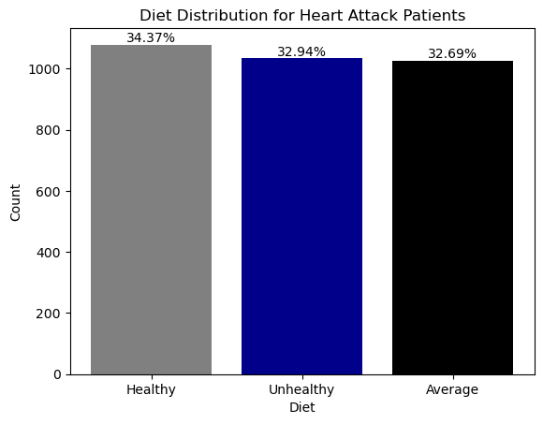
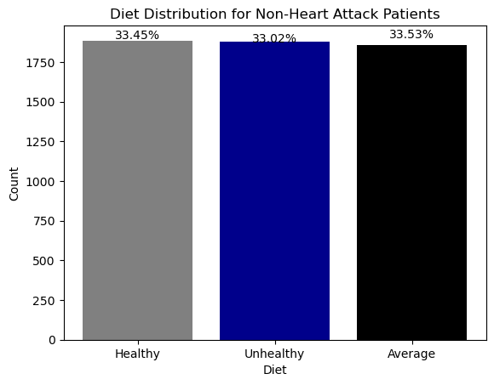
Influence of Diet on Heart Attacks
The "Average" diet was the most common among those that didn’t have heart attacks, with 1,886 individuals (33.80% of the total).
"Healthy" and "Unhealthy" diets were nearly equally distributed, with 1,881 (33.72%) and 1,857 (33.48%) individuals, respectively.
The majority of patients who had a heart attack followed a “Healthy" diet, with 1,079 individuals (34.37% of the total)

Slide 7
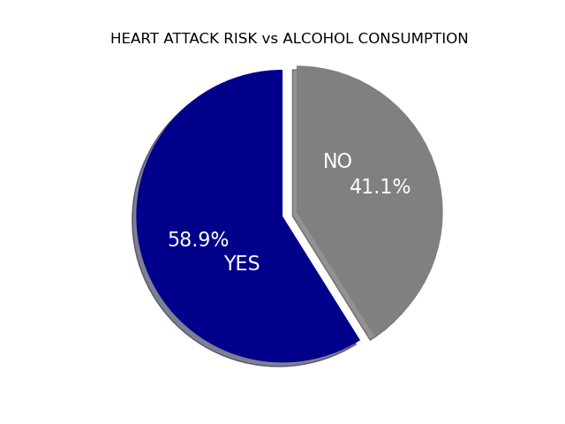
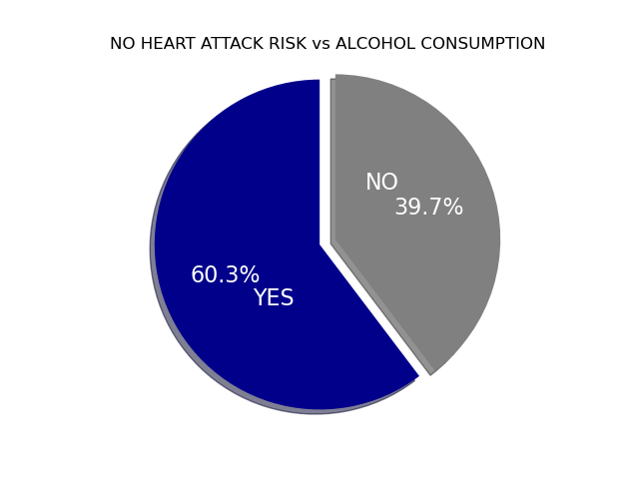
Influence of Alcohol Consumption on Heart Attacks
Among individuals who experienced heart attacks, a significant 58.9% were found to be regular consumers of alcohol. Interestingly, when comparing this to the population without heart attacks, the distribution is quite similar, with observations indicating that 60.3% of those who did not have heart attacks also engage in regular alcohol consumption.
This similarity in alcohol consumption patterns between the two groups highlights the need for a more comprehensive examination of other risk factors contributing to heart attacks and underscores the complex nature of heart health.

Slide 8
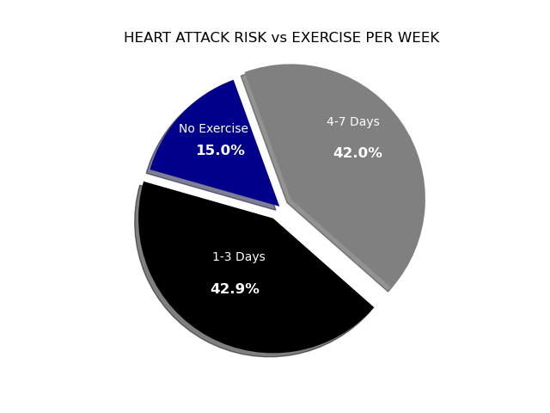
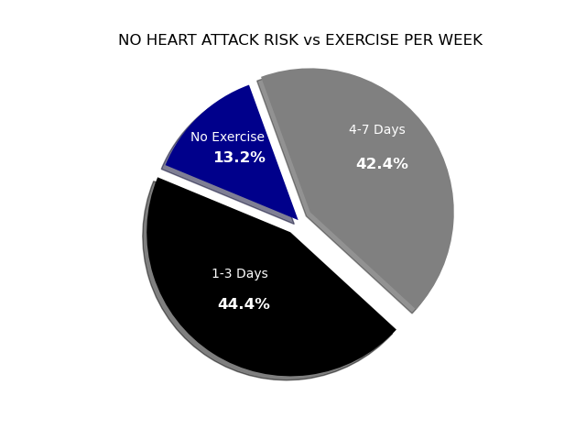
Influence of Exercise on Heart Attacks
Among individuals who suffered heart attacks, it is notable that a significant proportion (42.9%) engaged in exercise 1-3 days per week, similarly 42% exercised 4-7 days per week. However, 15% of heart attack cases were among those who did not exercise at all.
The data reveals a noteworthy observation: a minimal prevalence of physical activity engagement among patients with no risk of heart attack. However, it's essential to note that these findings may not provide conclusive evidence, as the distribution of physical activity among this group closely resembles that of patients with a high risk of heart attack.

Slide 9
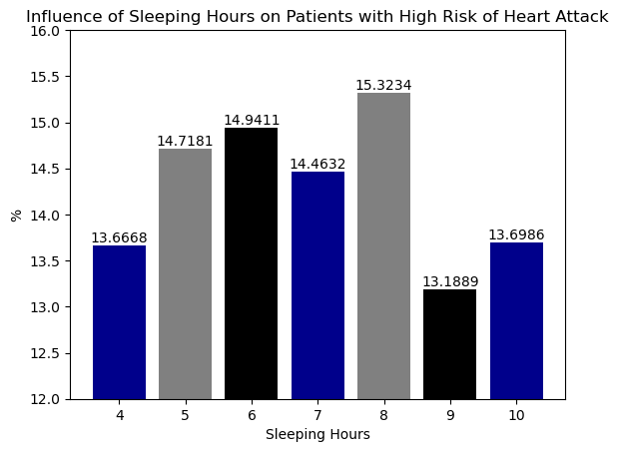
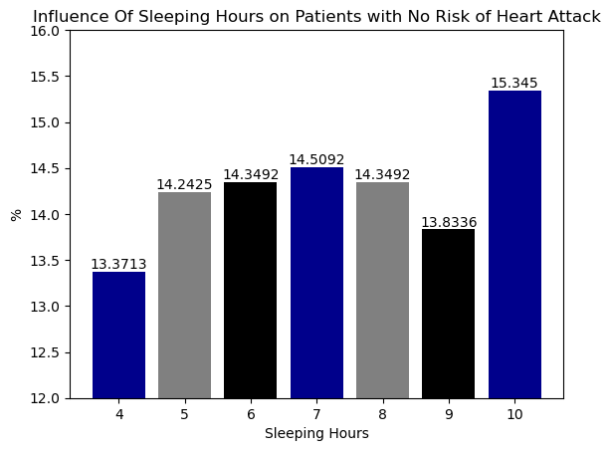
Influence of Sleeping Hours on Heart Attacks
We observed that, in terms of the number of sleeping hours, both distributions are characterized by moderate peaks. More patients with a high risk of heart attacks have 8 hours of sleep, while more of those with no risk of heart attack sleep 10 hours. In both cases, the least common results in the studied sample were associated with either 4 hours or 9 hours of sleep.

Slide 10
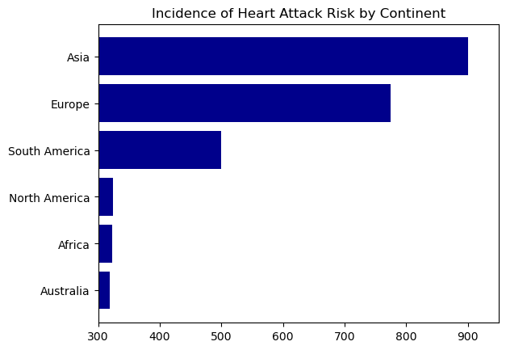
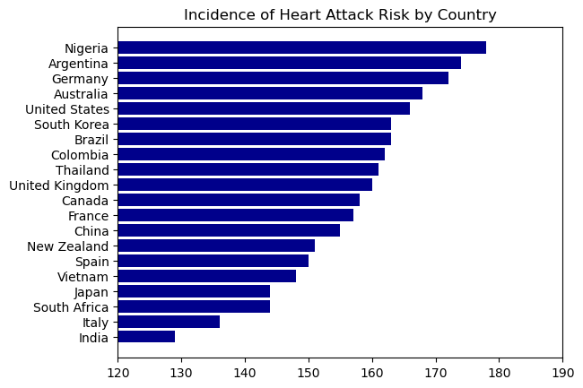
Influence of Location on Heart Attacks
Out of the total number of patients in the sample with a high risk of heart attack, 900 patients originally hailed from Asia, and 775 were of European origin. It appears that both Asia and Europe have a higher incidence of heart attack risk. However, when we delve deeper into the breakdown by country, it's noteworthy that the top two countries with the highest quantity of patients at high risk of heart attack are not part of these continents. Nigeria and Argentina, surprisingly, top the list with the highest number of such patients. In the third position, German nationals also exhibit a significant risk of heart attack, with 172 patients in this category

Slide 11
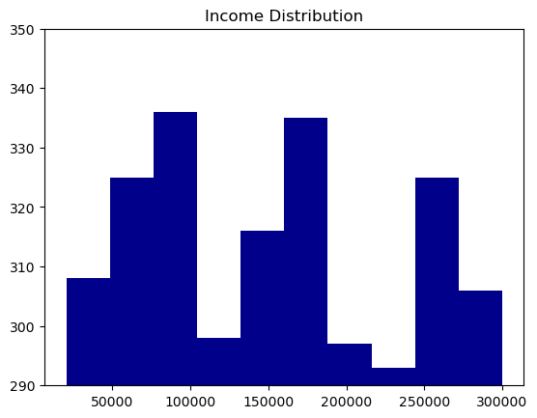
Influence of Income on Heart Attacks
The income distribution in the sample appears to lack a distinct pattern. The data only indicates a lower prevalence of patients falling within the income ranges of 100,000 to 150,000 and 180,000 to 250,000.

Slide 12
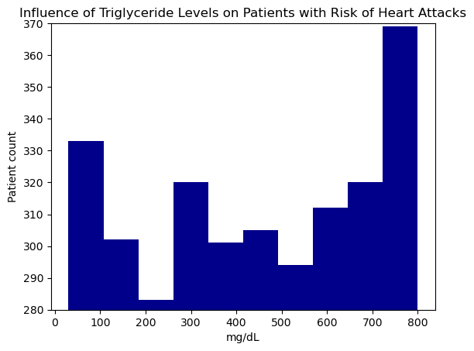
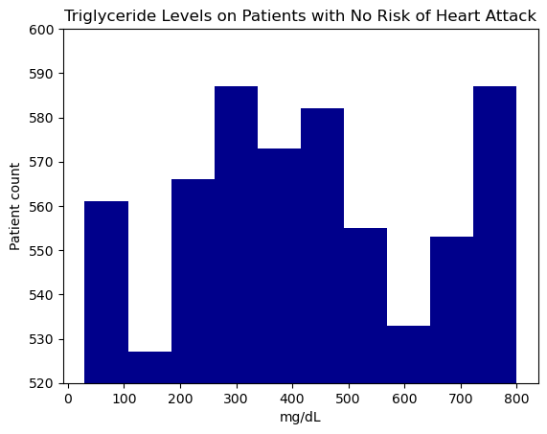
Influence of Triglyceride Levels on Heart Attacks
The distribution of triglyceride levels among patients with a high risk of heart attack exhibited a slight negative bias, suggesting that higher triglyceride levels are associated with a greater number of patients at high risk of heart attacks. Conversely, when examining the distribution of patients with no risk of heart attack, it becomes evident that the distribution is highly asymmetric.

Slide 13
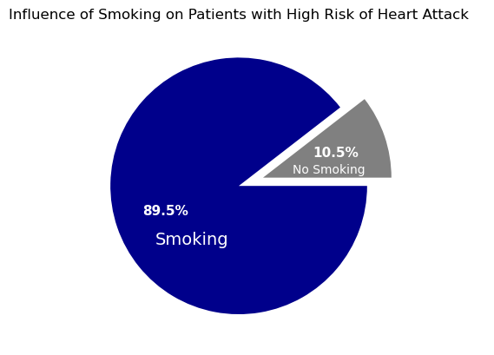
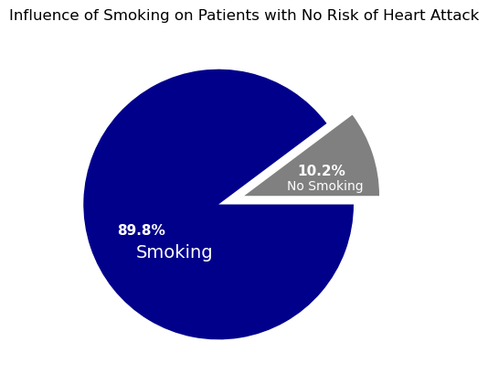
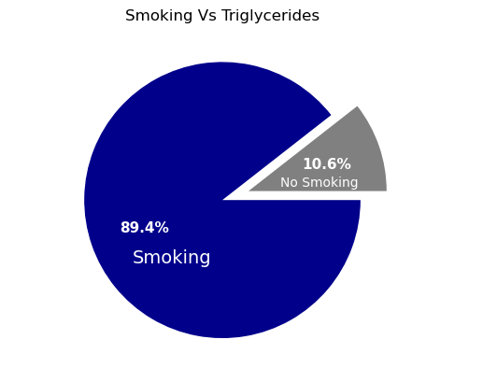
Influence of Smoking on Heart Attacks
Analysis of the smoking habits of patients with high and low risks of heart attacks did not reveal significant differences. However, an interesting finding from the data is that patients who smoke tend to exhibit higher levels of triglycerides. As a result, based on the data we've examined, it suggests that this type of blood fat might serve as a more reliable indicator for predicting the risk of heart attack.

Slide 14
Multifactorial Analysis on Patients with High Risk of Heart Attack

Slide 15
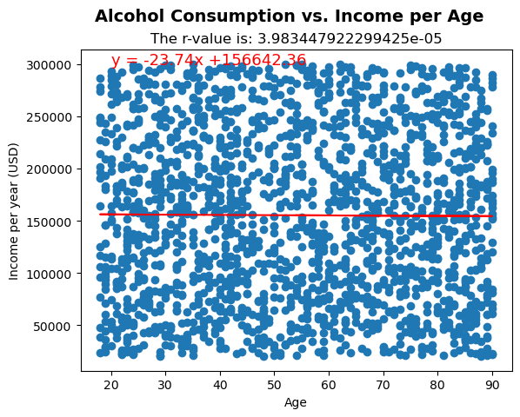
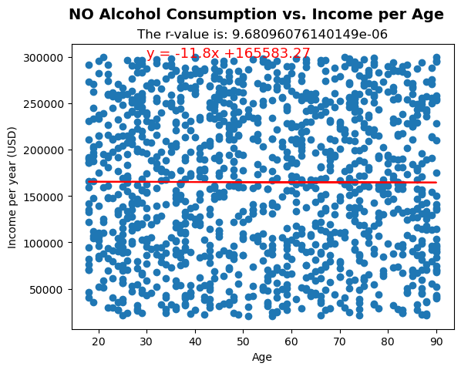
Alcohol Consumption vs. Income per Age
Among the high-risk heart attack patients, we conducted an analysis to examine the potential association between alcohol consumption and age. Our findings revealed a substantial degree of variability in the results. Specifically, the p-value for patients who consume alcohol was calculated to be 3.08e-05, while for those who abstain from alcohol, it was 9.68e-06. These results unequivocally indicate that there is no discernible correlation between alcohol consumption and age in high-risk heart attack patients

Slide 16
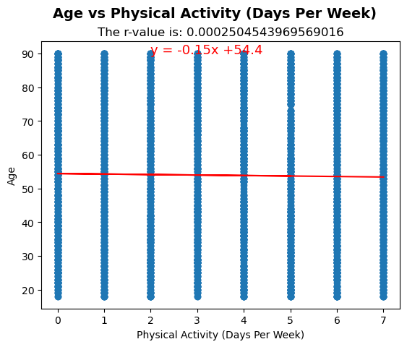
Age vs. Physical Activity
Regarding the connection between the age of high-risk heart attack patients and their level of physical activity, our analysis yielded limited insights. The p-value, standing at 0.00025, suggests an absence of correlation between these variables. The examined population showed no apparent association between age and physical activity, which contrasts with conventional wisdom.

Slide 17
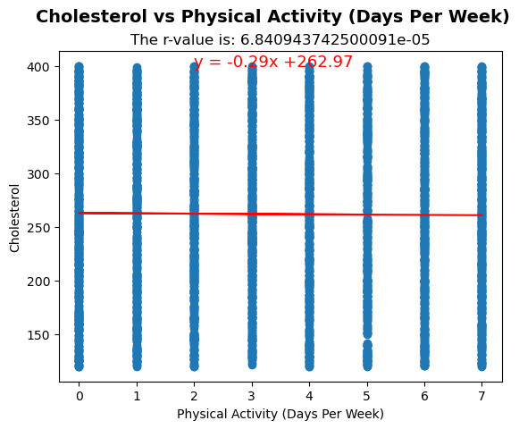
Cholesterol Level vs. Physical Activity
As with previous multifactorial analyses, our correlation study fails to identify any significant relationship between cholesterol levels and physical activity

Slide 18
Conclusions
The results obtained from the analysis of this dataset are highly inconclusive. There is a striking level of symmetry observed when comparing the influence of different variables on high or low risk of experiencing a heart attack.
Based on the results obtained, there is limited evidence to suggest that the type of diet, alcohol consumption, exercise or number of sleeping hours have a significant influence on the likelihood of experiencing a heart attack.
The findings indicate that triglyceride levels may exert an influence on patients with a higher risk of heart attack.
The data concerning smoking habits did not yield conclusive results regarding the direct impact of this habit on the risk of having a heart attack. However, when exploring the interaction between smoking and triglyceride levels, we did observe a notable tendency for patients with a high risk of heart attack to exhibit elevated triglyceride levels. These findings suggest that smoking may be indirectly related to heart attacks through its influence on triglyceride levels.
Upon conducting the multifactorial analysis, the results have raised doubts about the methodology employed in sample selection. The data reveals counterintuitive findings that contradict commonly accepted knowledge.
Limitations in the Analysis:
One of the limitations we've identified in this analysis is the absence of information regarding the methodology used for sample selection, making it challenging to ascertain whether the sample was chosen randomly. Additionally, the definition of "risk of heart attack" is represented by binary values, which lack the necessary details to shed light on the nature of this parameter. Acquiring more comprehensive information about how this value is determined could potentially offer valuable insights into some of the obtained results.

Slide 19
Questions and Answers…
Thank you for your attention.

